Slide 1
Working with images and scenes
CS 5010 Program Design Paradigms “Bootcamp”
Lesson 2.5
© Mitchell Wand, 2012-2014
This work is licensed under a Creative Commons Attribution-NonCommercial 4.0 International License.
TexPoint fonts used in EMF.
Read the TexPoint manual before you delete this box.: AAA

Slide 2
Introduction
Racket has a rich library for working with images and scenes.
We will use this library extensively in this course.
In this lesson, we will explore a few things from the library.
Note: this lesson is mostly review from Lesson 0.4

Slide 3
Learning Objectives
At the end of this lesson, the student should be able to:
  Create simple images and scenes
  Combine simple images into more complex images and scenes
  Determine the properties of an image
  Test images and their properties

Slide 4
Images are Scalar Data
In Racket, images are scalar data
Racket has:
  Functions for creating images
  Functions for combining images
  Functions for finding properties of images
In general, we build complex images by starting with simple images and then combining them using functions.

Slide 5
Loading the image library
To load the image library, include the line
(require 2htdp/image)
in your program.

Slide 6
Functions for Creating Images (1)
bitmap : String -> Image
GIVEN: the name of a file containing an image in .png or .jpg format
RETURNS: the same image as a Racket value.

Slide 7
Functions for Creating Images (2)
rectangle :
Width Height Mode Color -> Image
GIVEN: a width and height (in pixels), a mode (either the string “solid” or the string “outline”), and a color
RETURNS: an image of that rectangle.
[See the Help Desk for information on the representation of colors in Racket].

Slide 8
Functions for Creating Images (3)
circle : Radius Mode Color -> Image
Like rectangle, but takes a radius instead of a width and height.
There are lots of other functions for creating shapes, like ellipse, triangle, star, etc.

Slide 9
Functions for Creating Images (4)
text
: String Fontsize Color -> Image
RETURNS: an image of the given text at the given font size and color.

Slide 10
Combining Images
The image library contains many functions for combining images into larger images.
These functions generally align the images on their centers. This is usually what you want. If you really want to align images on their edges, there are functions in the library to do that, too. See the help desk, as usual.
Let’s look at the two most commonly-used image combining-functions: beside and above. Here’s an example:

Slide 11
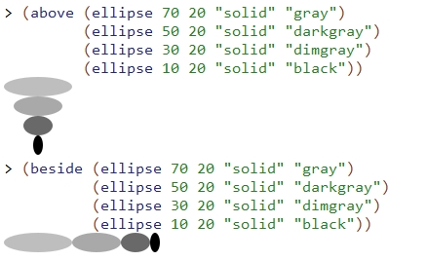
beside and above

Slide 12
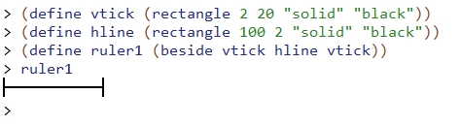
Slightly more complicated images

Slide 13
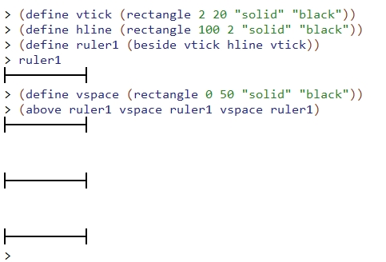
Slightly more complicated images
The rectangle has width 0, so it's invisible ☺

Slide 14
Scenes
A scene is an image that has a coordinate system.
In a scene, the origin (0,0) is in the top left corner. The x-coordinate increases as we move to the right. The y-coordinate increases as we move down. These are sometimes called “computer-graphics coordinates”
We use a scene when we need to combine images by placing them at specific locations.

Slide 15
Scene Coordinates
x
(0,0)
y

Slide 16
Creating Scenes
(empty-scene width height)
  returns an empty scene with the given dimensions.
(place-image img x y s)
  returns a scene just like s, except that image img is placed with its center at position (x,y) in s
  resulting image is cropped to the dimensions of s.

Slide 17
scene+line
(scene+line s x1 y1 x2 y2 color)
  returns a scene just like the original s, but with a line drawn from (x1,y1) to (x2,y2) in the given color.
  the resulting scene is cropped to the dimensions of s.

Slide 18
Creating Scenes with Functions Composition
Create scenes with images in them by combining them with functions.
Start with an empty-scene, then paint images and lines on the scene by using place-image and scene+line.
This is all functional: painting an image on a scene doesn’t change the scene– it produces a new scene.

Slide 19

Video Demonstration
YouTube link

Slide 20
Measuring Images
Racket also provides functions for determining image properties. Here the most important ones:
  image-width : Image -> NonNegInt
  image-height : Image -> NonNegInt
  image? : Any -> Boolean
In pixels

Slide 21
Bounding Box
The bounding box of an image is the smallest rectangle that completely encloses the image.
Its width will be the image-width of the image, and its height will be the image-height of the image.
It is easy to determine whether an arbitrary point is inside the bounding box– let’s look at an example.

Slide 22

Bounding Box Example
(x0,y0)
y = y0-h/2
(x,y) is inside the rectangle iff
(x0-w/2) ≤ x ≤ (x0 + w/2)
and (y0-h/2) ≤ y ≤ (y0+h/2)
h =
(image-height CAT-IMAGE)
w = (image-width CAT-IMAGE)
y = y0+h/2
x = x0-w/2
x = x0+w/2

Slide 23
Images and the Design Recipe: Examples
In your examples, describe the image in words.
EXAMPLE: Consider a function that takes an image and doubles it.
In your examples you could write:
  (define red-circle1
  (circle 20 "solid" "red"))
  ;; (double-image red-circle1)
  ;; = two red circles, side-by-side

Slide 24
Images and the Design Recipe: Tests (1)
First, construct the correct image. Do NOT use the function you are testing to construct the image.
EXAMPLE:
(define two-red-circles
(beside red-circle1 red-circle1))
Check it visually to see that it's correct
  Alas, this step is not automatable.

Slide 25
Images and the Design Recipe: Tests (2)
Then you can use check-equal? on the resulting images:
  (check-equal?
  (double-image red-circle1)
  two-red-circles)
This looks a little silly now, but it will be helpful when you build more complicated images.

Slide 26
Images and the Design Recipe: Tests (3)
check-equal? is fairly clever, but not perfect.
Which of the images below are visually equal?
See which of them check-equal? accepts as equal.
(define vspace1 (rectangle 0 50 "solid" "black"))
(define vspace2 (rectangle 0 50 "solid" "white"))
(define vspace3 (rectangle 0 50 "solid" "red"))
(define vspace4 (rectangle 0 50 "outline" "black"))
(define vspace5 (rectangle 0 50 "outline" "white"))

Slide 27
Summary
Images are ordinary scalar values
Create and combine them using functions
Scenes are a kind of image
  create with empty-scene
  build with place-image
2htdp/image has lots of functions for doing all this.
  Go look at the help docs

Slide 28
Next Steps
If you have questions or comments about this lesson, post them on the discussion board.

